Slide 1

Computer Engineering Department A.P. Shah Institute of Technology G.B.Road,Kasarvadavli, Thane(W), Mumbai-400615 UNIVERSITY OF MUMBAI Academic Year 2019-2020

Slide 2
A Project Report on CUSTOMER CLASSIFICATION PREDICTION MODEL FOR ONLINE STORE Submitted in partial fulfillment of the degree of Bachelor of Engineering(Sem-8) in Computer Engineering By Arhanti Gawde(16102026) Arpita Hirlekar(16102018) Snehal Surve(17202013) Under the Guidance of Prof. Pravin Adivarekar

Slide 3
1.Project Conception and Initiation

Slide 4
1.1 Abstract
This paper deals with classification of the customers as a part of the marketing strategy in order to expand the business profit by understanding the relationship between the customers and the products that they purchase.
Classification of the customer proves to be helpful since it targets the specific customer for the specific product. This will help the company heighten the level of information to the appropriate customers.
This model will serve the purpose of identifying the customers who will most likely respond to the recommendations by the company based on their past purchasing history.

Slide 5
1.2 Introduction
Identifying the potential customers of certain products and promoting the products accordingly is an important concept of almost all businesses nowadays. There are two methods for advertisements and promotions, namely mass marketing and direct marketing. Mass marketing is a procedure wherein the promotion of the products is carried out by targeting the general public through media such as newspapers, radios and televisions.
Therefore rather than going forward with such an unreliable method, the marketers are now shifting their focus from traditional Mass Marketing to Direct Marketing. We are using ELK in our project for identifying different customers on the basis of their past purchases, their time of purchase, brand they purchase, etc. Our project develops predictive analysis using an analysis software known as ELK (Elasticsearch, Logstash and Kibana) in order to predict the bifurcate the customers according to their shopping time, history, choice, etc. This framework is computationally effective and can be connected by numerous degrees of opportunity.

Slide 6
1.3 Objectives
The objective of this project is to build a model that will accept a big data and classify customers based on the basis of their purchase history, purchase time, brand, etc. and give the business a good and detailed report of the analysis.
After customers are classified, the company or the business will not have to face the excess of expenditure in providing irrelevant recommendations for new products that will be launched on the website.
The company will be benefited because it can send recommendation only to customers who are likely to revert to the recommended product.

Slide 7
1.4 Literature Review
Title: A customer classification prediction model based on machine learning techniquesAuthor: T. K. DasIn this paper, the author has basically tried out experimenting the mining of data using various methods like Naı̈ve Bayes, KNN and SVM to classify a bank customer data.Naı̈ve Bayes: Naı̈ve Bayes algorithm is a probabilistic classifier. It splits the attributes into independent ones.
Title: Data Mining Framework for Direct Marketing1Author: Lilian Sing’oei, Jiayang WangAbout The Paper: The objective of this paper is to provide a comprehensive framework to guide research efforts focusing on direct marketing strategyDecision Tree: Decision Tree algorithm belongs to the family of supervised learning algorithms, decision tree algorithm are used for solving regression and classification problems.
Title: Decision Tree and Naı̈ve Bayes Algorithm for Classification and Generation of Actionable Knowledge for Direct MarketingAuthor: Masud Karim, Mohammad RashedurIn this work, the author has compared the working of different types of data mining techniques known as the Naive Bayes and the C4.5 decision tree algorithms. The goal of this work is to predict whether a client will subscribe a term deposit.

Slide 8
1.5 Problem Definition
To generate a model that will accept a big data and classify customers on some constraints and make clusters of customers who portray some or the other common characteristics.
Clusters will be having different customers on the basis of their past purchases, their time of purchase, the brand they purchase, etc.

Slide 9
1.6 Scope
Direct marketing deals with an important issue of identifying customers who are more likely to respond to the new offers.
This project develops predictive analysis using an analysis software known as ELK (Elasticsearch, Logstash and Kibana) in order to predict the bifurcate the customers according to their shopping time, history, choice, etc.
The steps such as importing the dataset into the database, analysis of it, choosing parameters and accordingly creating certain visualizations and ultimately creating a detailed report of the analysis will be carried out using the software.
The scope of this project is to provide a comprehensive framework for the efforts taking place in direct marketing strategy.

Slide 10
1.7 Technology stack
Elastic Search –
Raw data flows into Elasticsearch from a variety of sources, including logs, system metrics, and web applications. Data ingestion is the process by which this raw data is parsed, normalized, and enriched before it is indexed in Elasticsearch. Once indexed in Elasticsearch, users can run complex queries against their data and use aggregations to retrieve complex summaries of their data.
Logstash –
Logstash is a free and open server-side data processing pipeline that ingests data from a multitude of sources, transforms it, and then sends it to your favorite ”stash.” Logstashdynamically ingests, transforms, and ships your data regardless of format or complexity. Logstash, one of the core products of the Elastic Stack, is used to aggregate and process data and send it to Elasticsearch.

Slide 11
Kibana –
Kibana is a free and open user interface that lets you visualize your Elasticsearch data and navigate the Elastic Stack. Kibana is an open source visualization tool which provides a beautiful web interface to visualize the Elasticsearch data. Kibana allows us to create real-time dashboards in browser based interfaces. Kibana has different visualization effects like bar charts, graphs, pie charts, maps, tables etc. It allows to save, edit, delete and share the dashboards.

Slide 12
2. Project Design

Slide 13
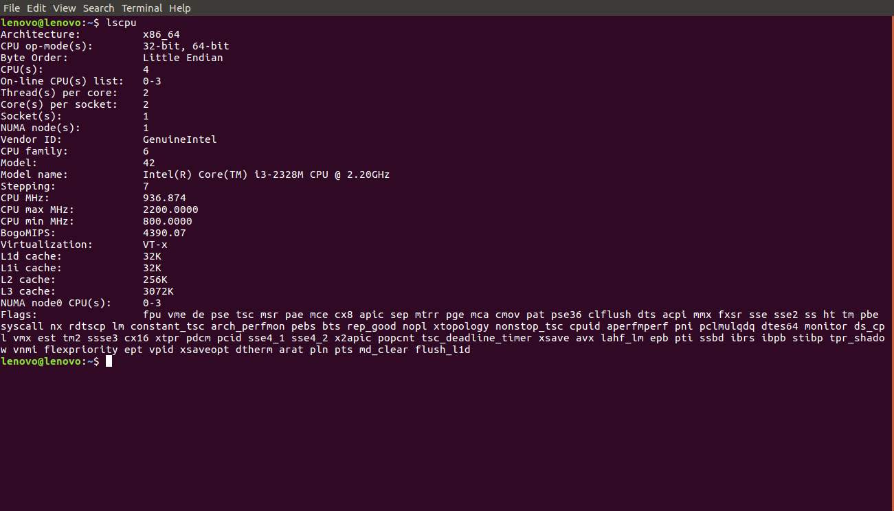
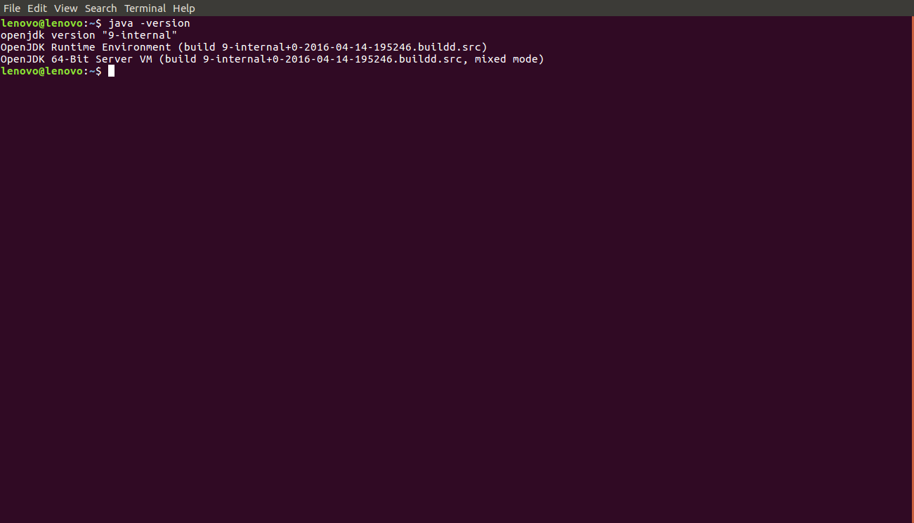
2.1 Implementation

Slide 16
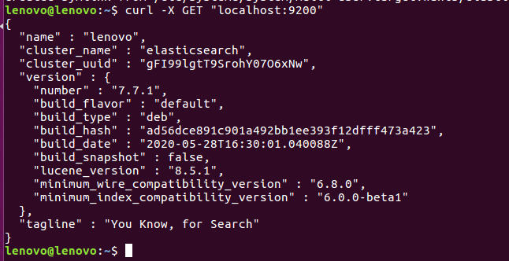


Slide 17
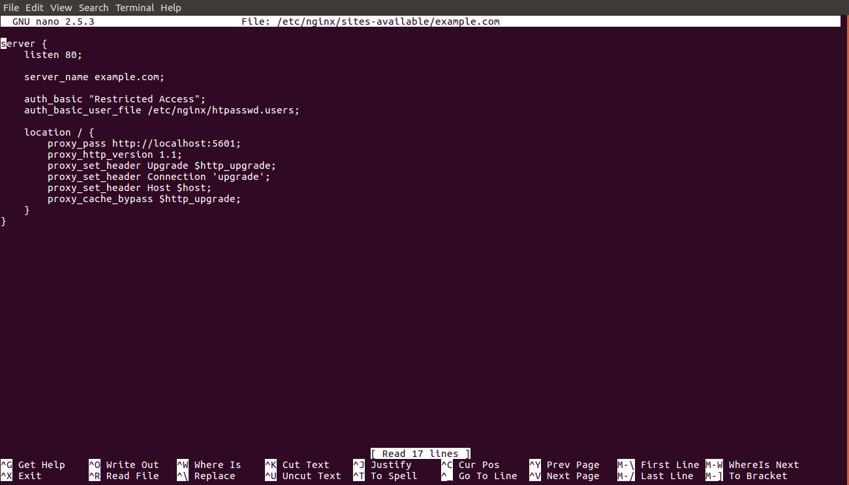

Slide 18
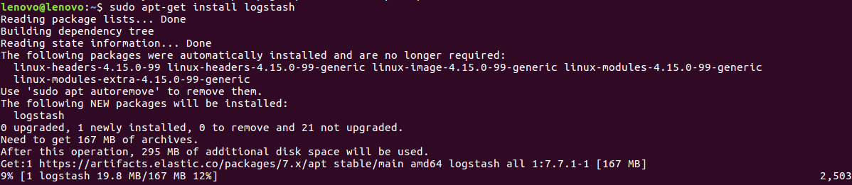
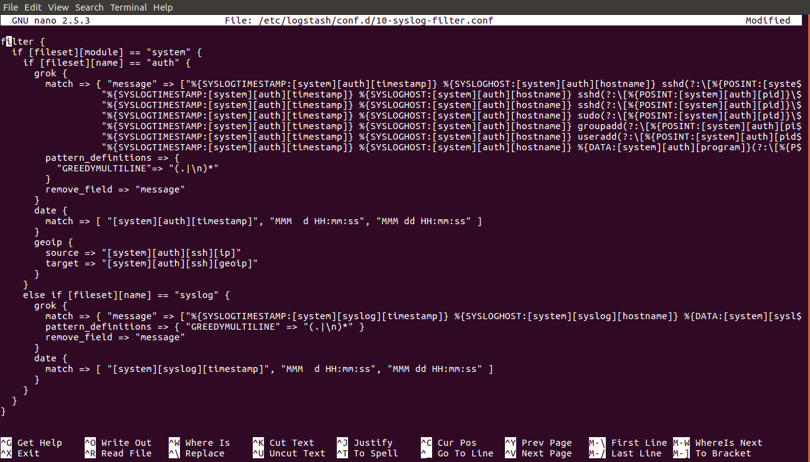

Slide 19
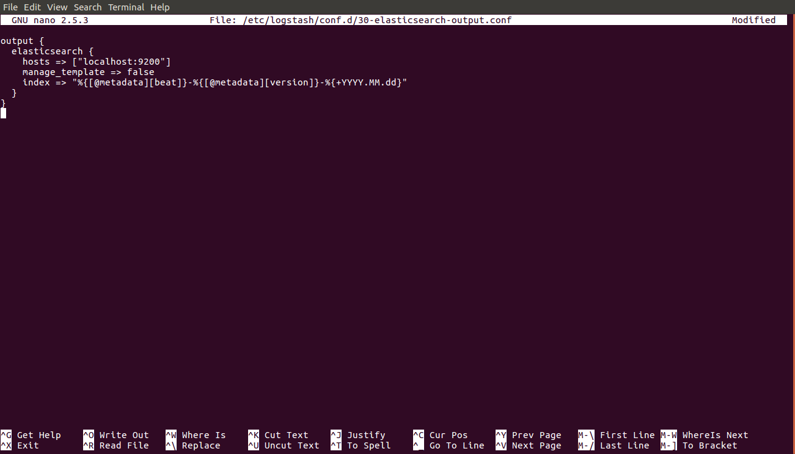

Slide 20
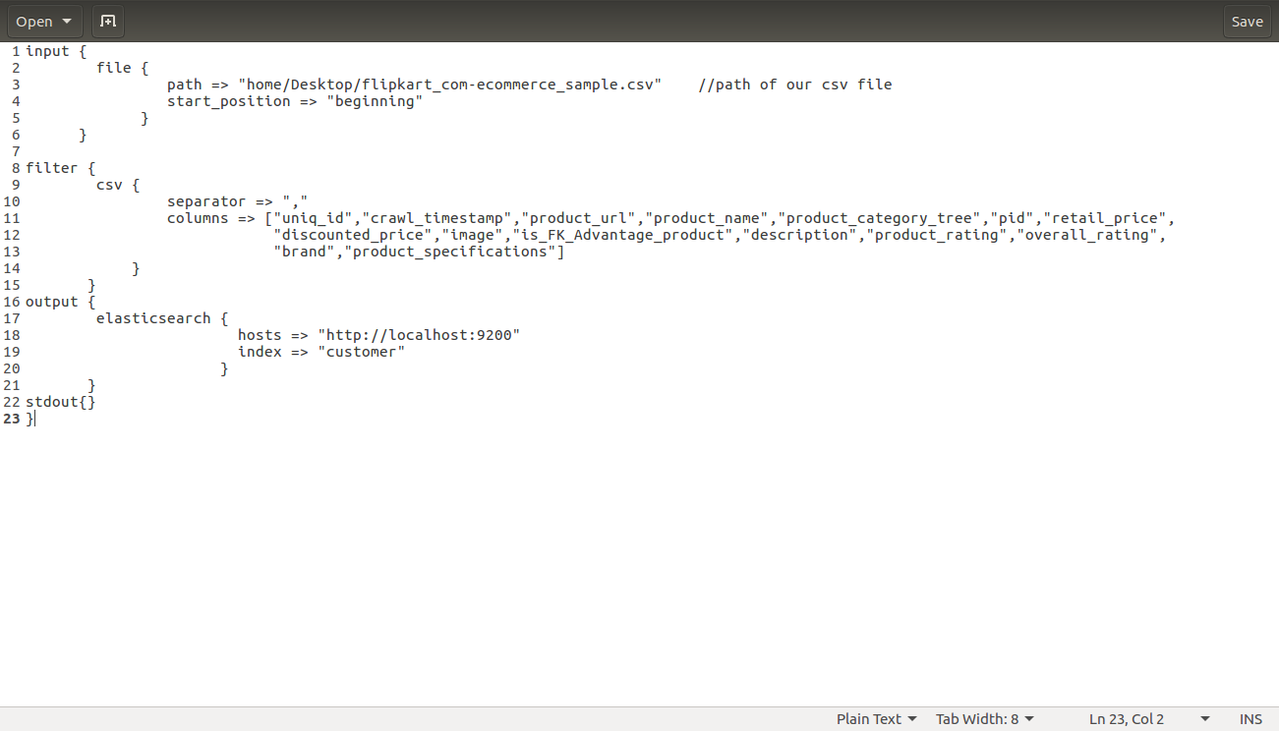

Slide 21
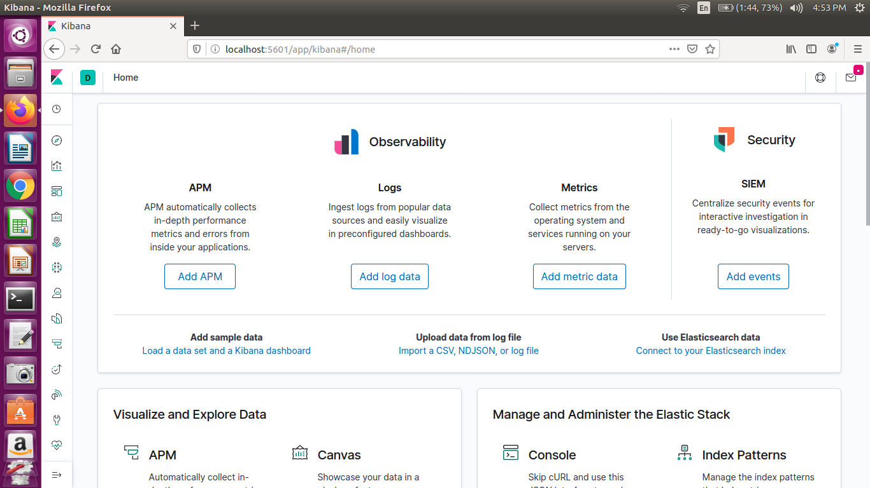
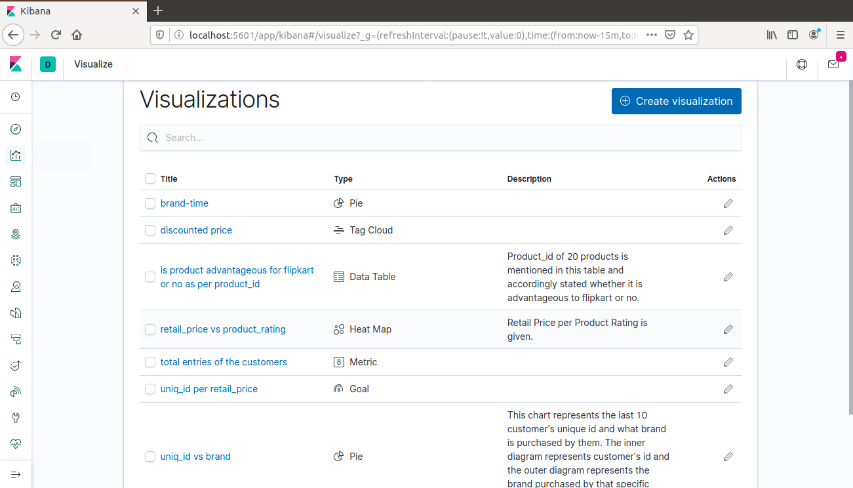

Slide 22
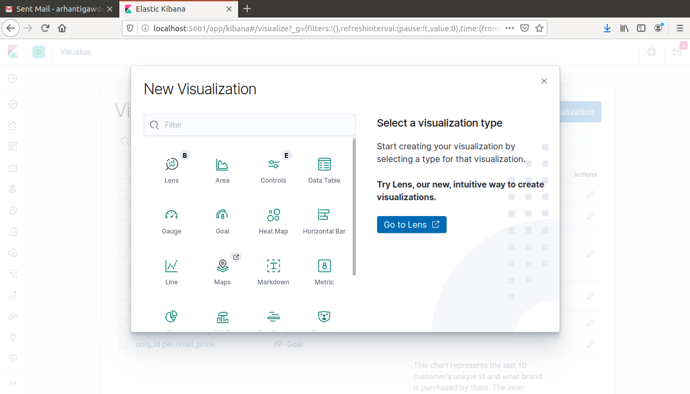
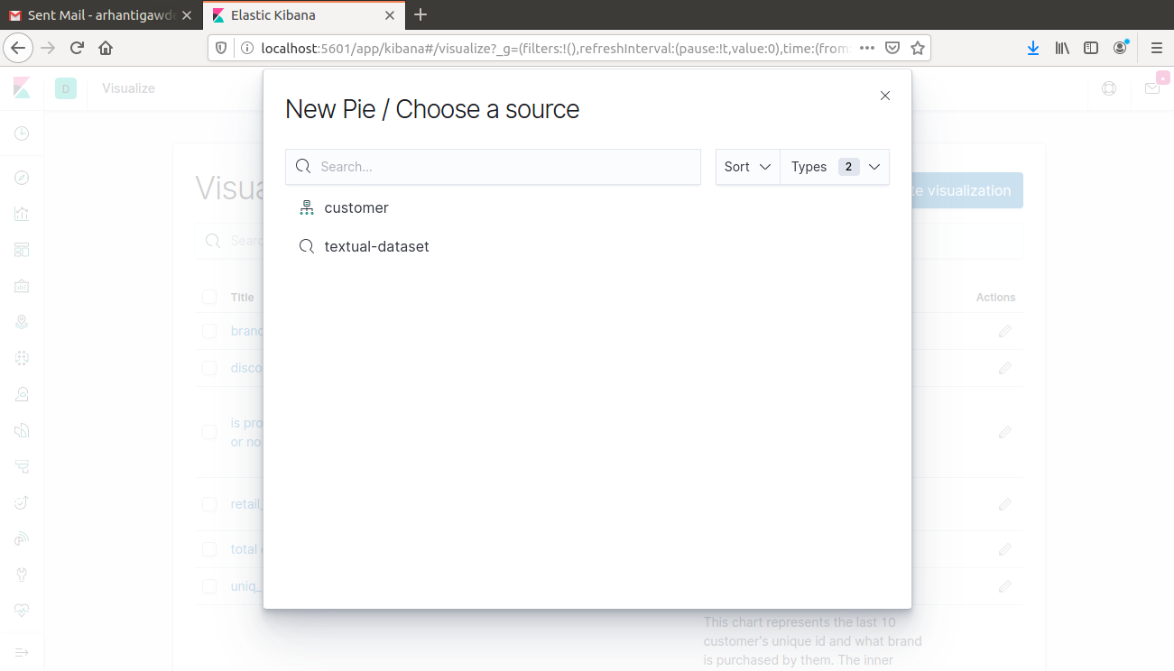

Slide 23
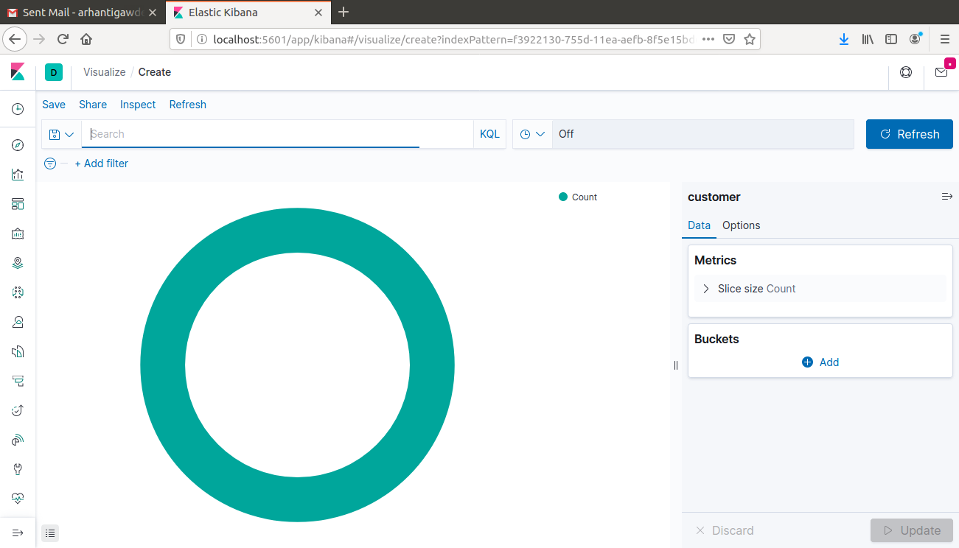

Slide 24
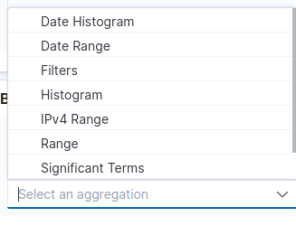
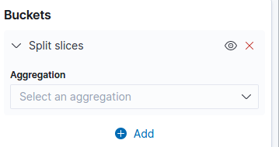

Slide 25
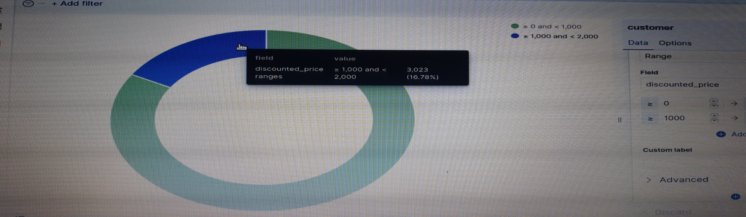
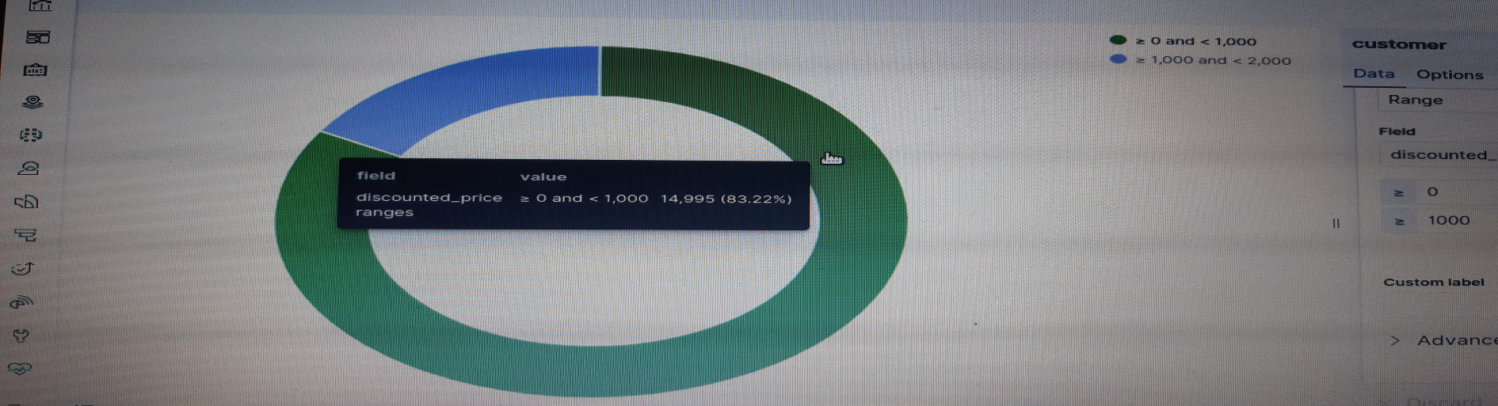

Slide 26
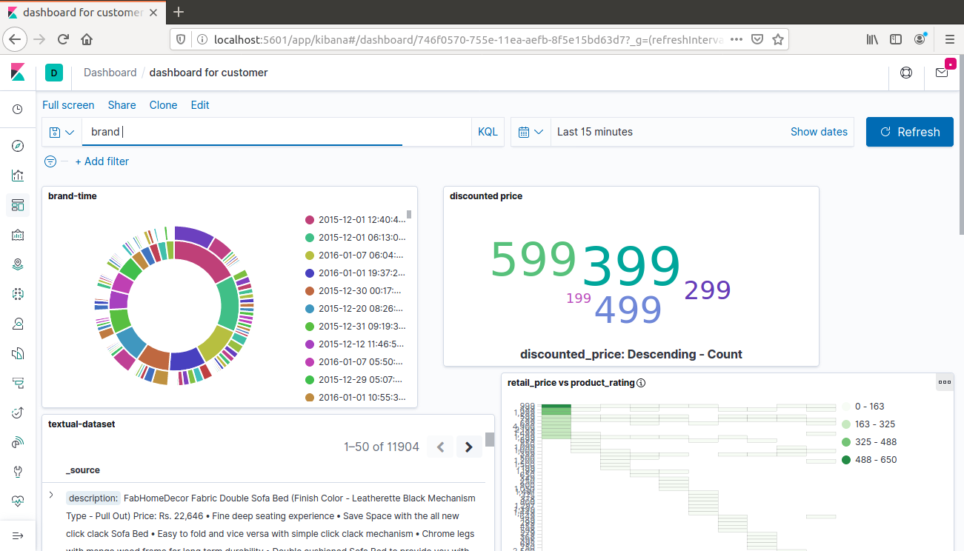

Slide 27
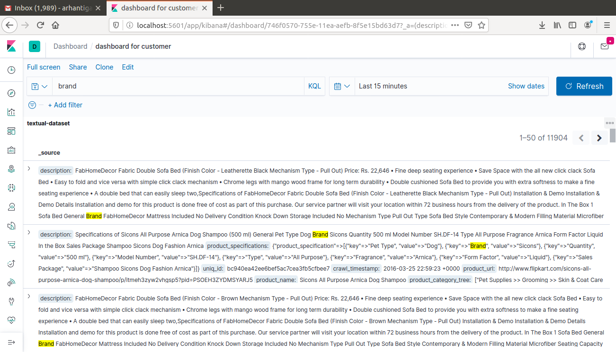

Slide 28
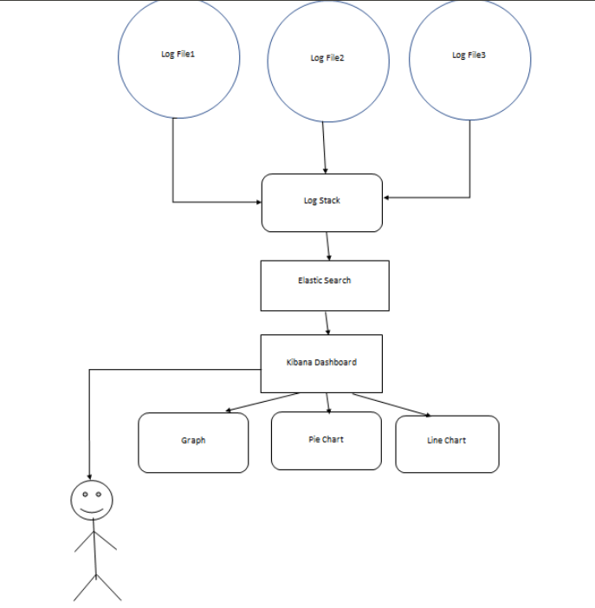
2.2 Use Case Diagram

Slide 29
2.3 Description Of Use Case
Log File - This files contain the data or information . There can be a number of log files.
Logstash - It collects the log files data and transfer it to elastic search for the further processing.• Elastic Search- Elasticsearch is the central component of the Elastic Stack, a set of open source tools for data ingestion, enrichment, storage, analysis, and visualization.
Kibana Dashboard- All the visualized and managed data are represented in the form of graph, Pie-chart, Line chart, Histogram etc.
User- The user is able to search and analyze the data . Here the user also can use this for many other purpose like monitoring, security analytics, business analytics etc.

Slide 30
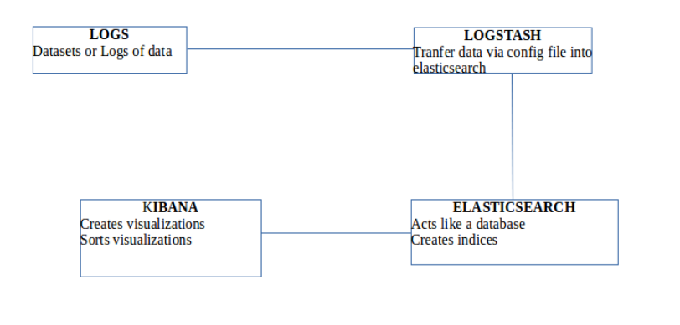
2.4 Class Diagram

Slide 31
2.5 Conclusion and Future Scope
The model accepts a big data and classify customers based on the basis of their purchase history, purchase time, brand, etc. and give the business a good and detailed report of the analysis. Providing special offers to particular group of customers on the website lets them know we appreciate them for visiting and shopping from our website.
Customers will get recommendations, different recommendations to different people, which will give customers products they might like resulting in increasing sales and thereby giving profit. This technique of direct marketing will prove to be helpful for not only online stores but also the ground shops. It can be applied to a variety of stores, industries, banks, etc.

Slide 32
2.6 References
[1] T. K. Das, “A Customer Classification Prediction Model Based on Machine Learning Techniques”
[2] K. Wisaeng, ”A Comparison of Different Classification Techniques for Bank Direct Marketing”
[3] Hany. A. Elsalamony, Alaa. M. Elsayad, ”Bank Direct Marketing Based on Neural Network”
[4] Lilian Sing’oei1, Jiayang Wang, ”Data Mining Framework for Direct Marketing: A Case Study of Bank Marketing”
[5] Eniafe Festus Ayetiran, ”A Data Mining-Based Response Model for Target Selection in Direct Marketing”
[6] Karim Masud, Rashedur M. Rahman, ”Decision Tree and Naı̈ve Bayes Algorithm for Classification and Generation of Actionable Knowledge for Direct Marketing”
[7] Paulo Cortez, ”Using Data Mining For Bank Direct Marketing: An Application Of The Crisp-DM Methodology”
[8] Customer Classification Based on The Historical Purchase Data - Leading India Paper

Slide 33
Thank You

